Slide 1

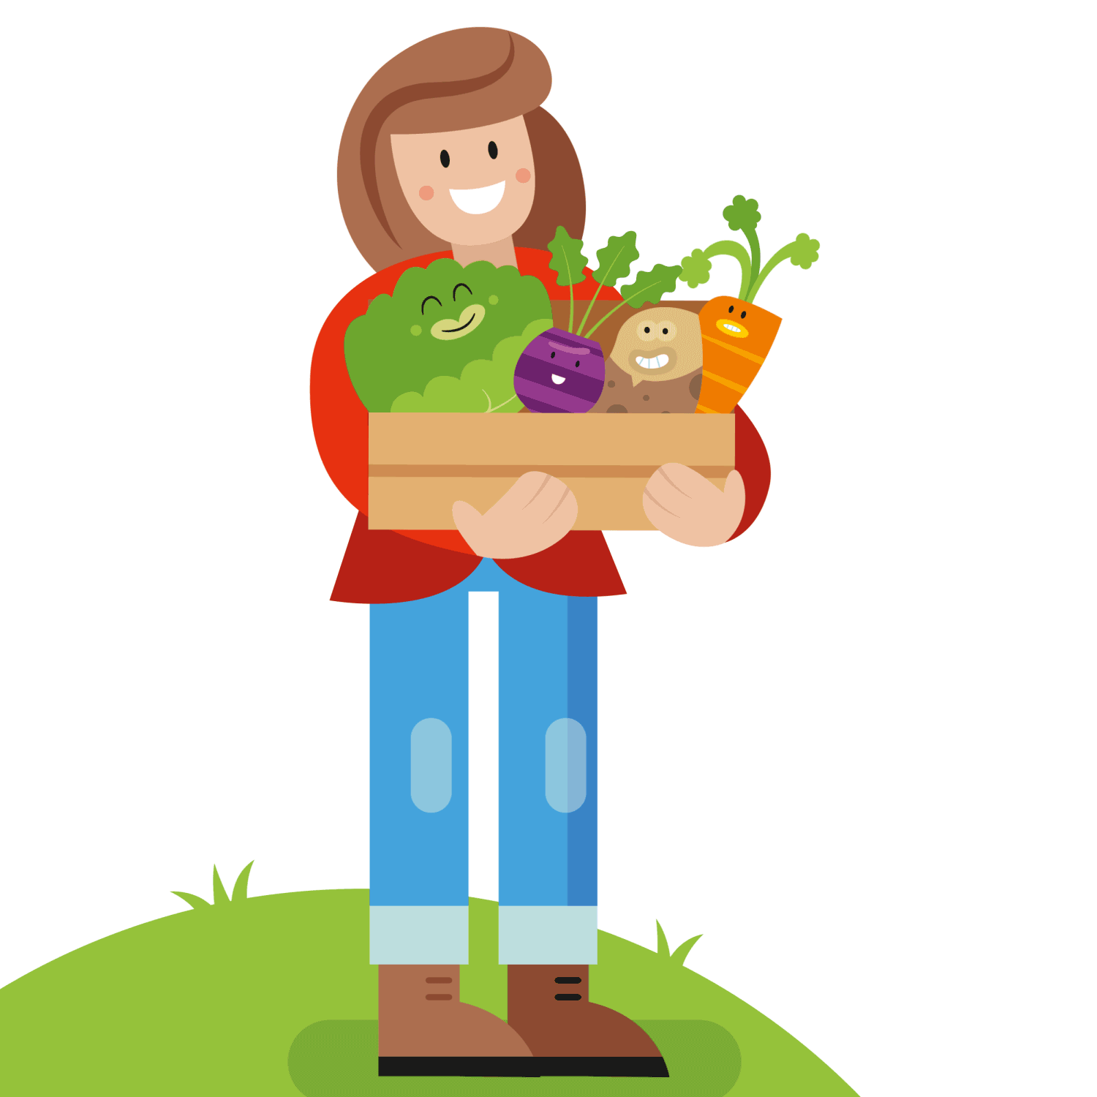
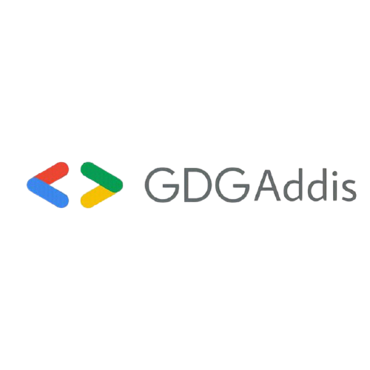

YIWEKUT-’ለገበሬው’

Slide 2
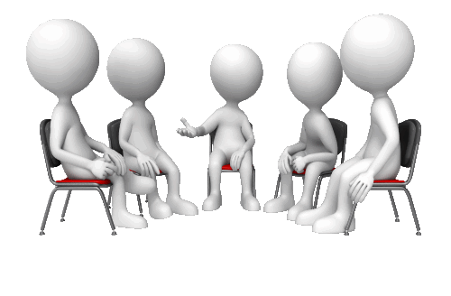
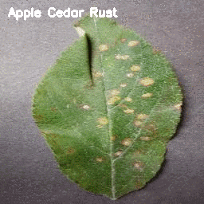
PROBLEM STATEMENT
Reduction in quality and quantity of products.
If severe, causes no grain harvest entirely.
Automatic identification and diagnosis in their early stage is highly desirable.
2

Slide 3
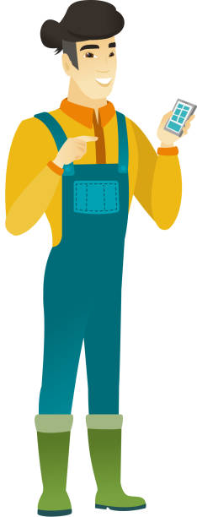
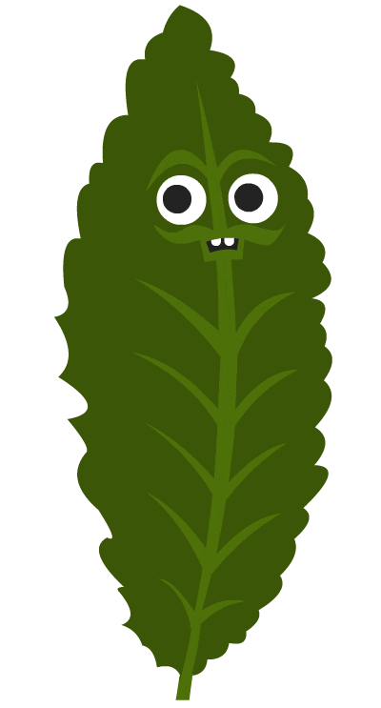
THE SOLUTION
A mobile app
Handy for a farmer.
Enables farmers to insert images of suspected diseased leaves.
Predict the type of plant disease.
Recommend remedy actions
Serves as a primary leaf image data collector

Slide 4
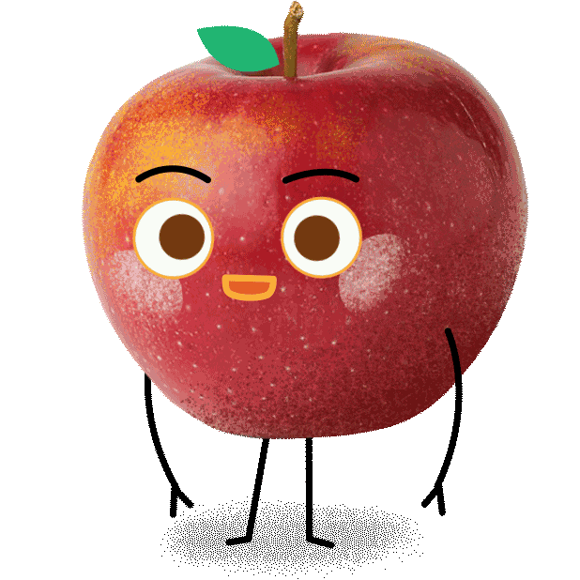
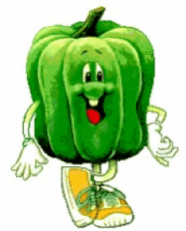
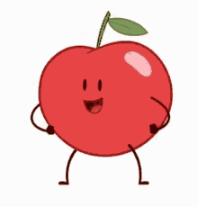


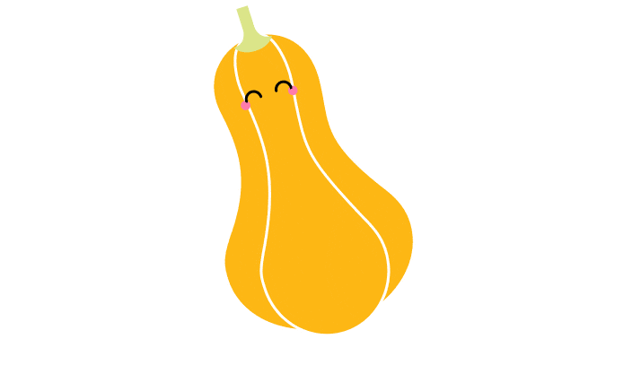

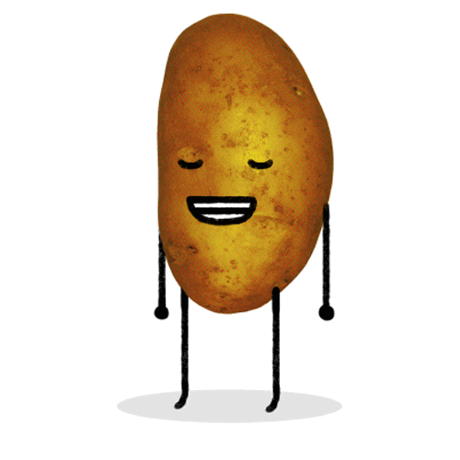



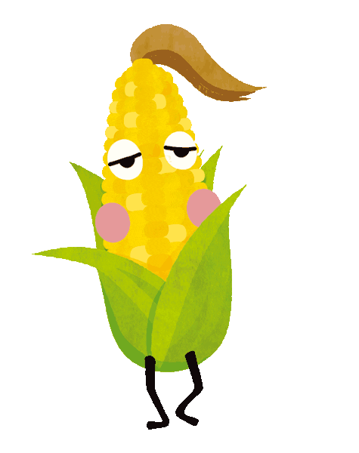
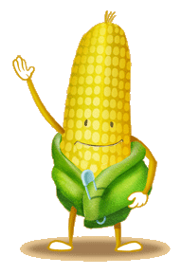
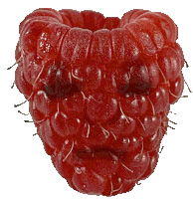
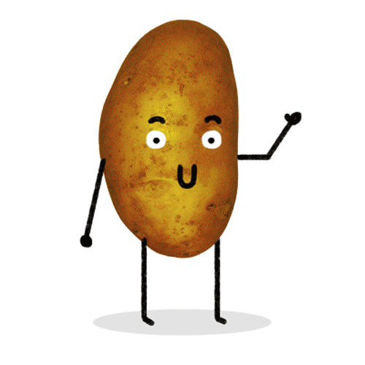

DATA PREPARATION
Apple (4)
Blueberry (1)
Cherry (2)
Corn (4)
Grape (4)
Orange (1)
Peach (2)
Pepper (2)
Potato (3)
Raspberry (1)
Soybean (1)
Squash (1)
Strawberry (2)
Tomato (10)
Plant Village Dataset from Kaggle
14 types of crops
26 types of disease diagnosis
38 distinct classes containing healthy groups

Slide 5

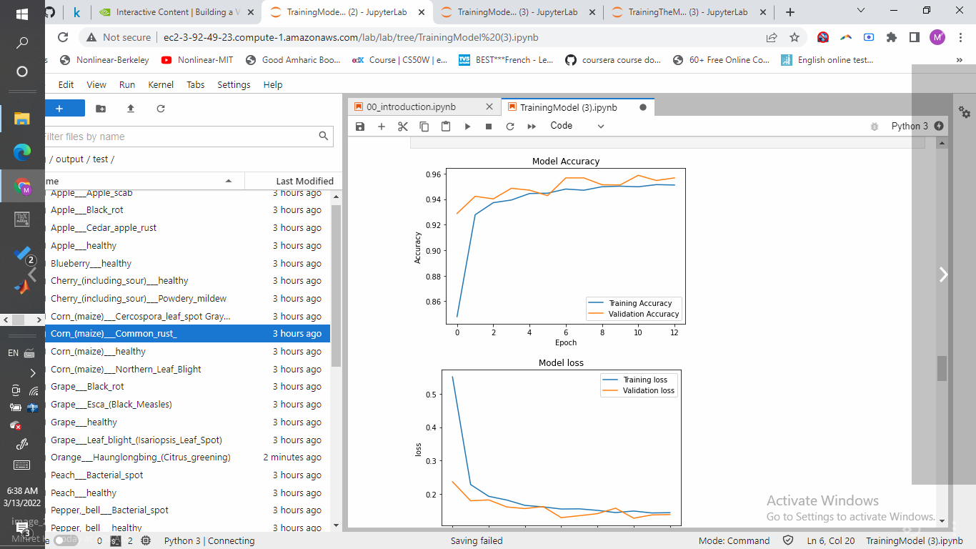
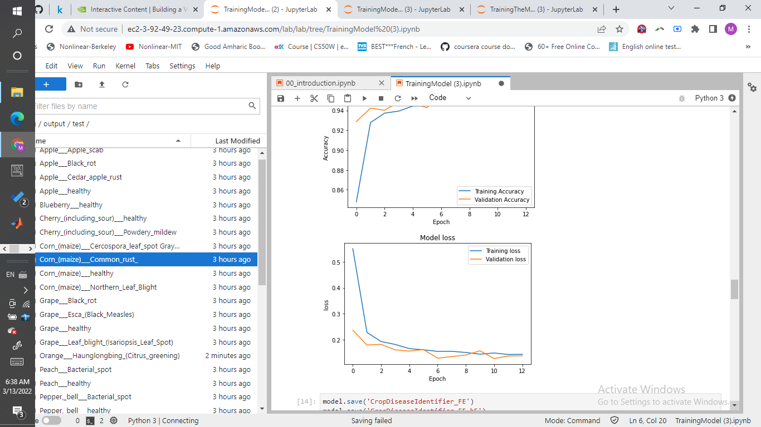

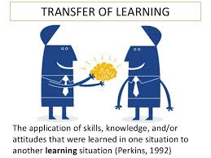

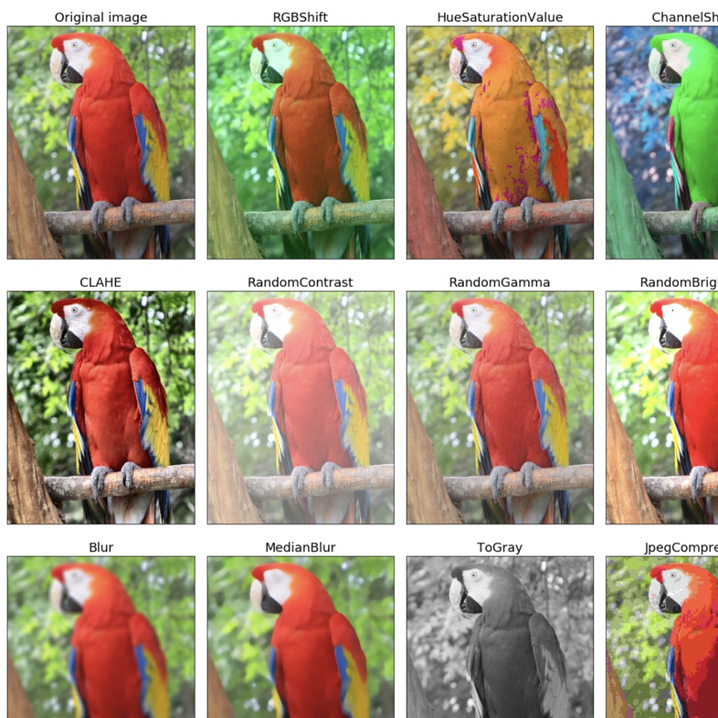
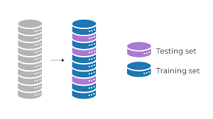
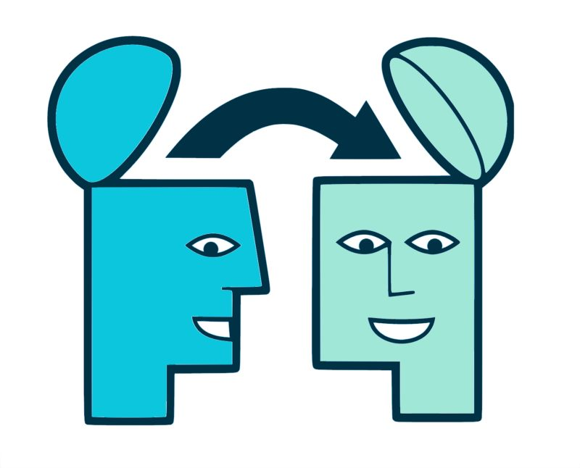
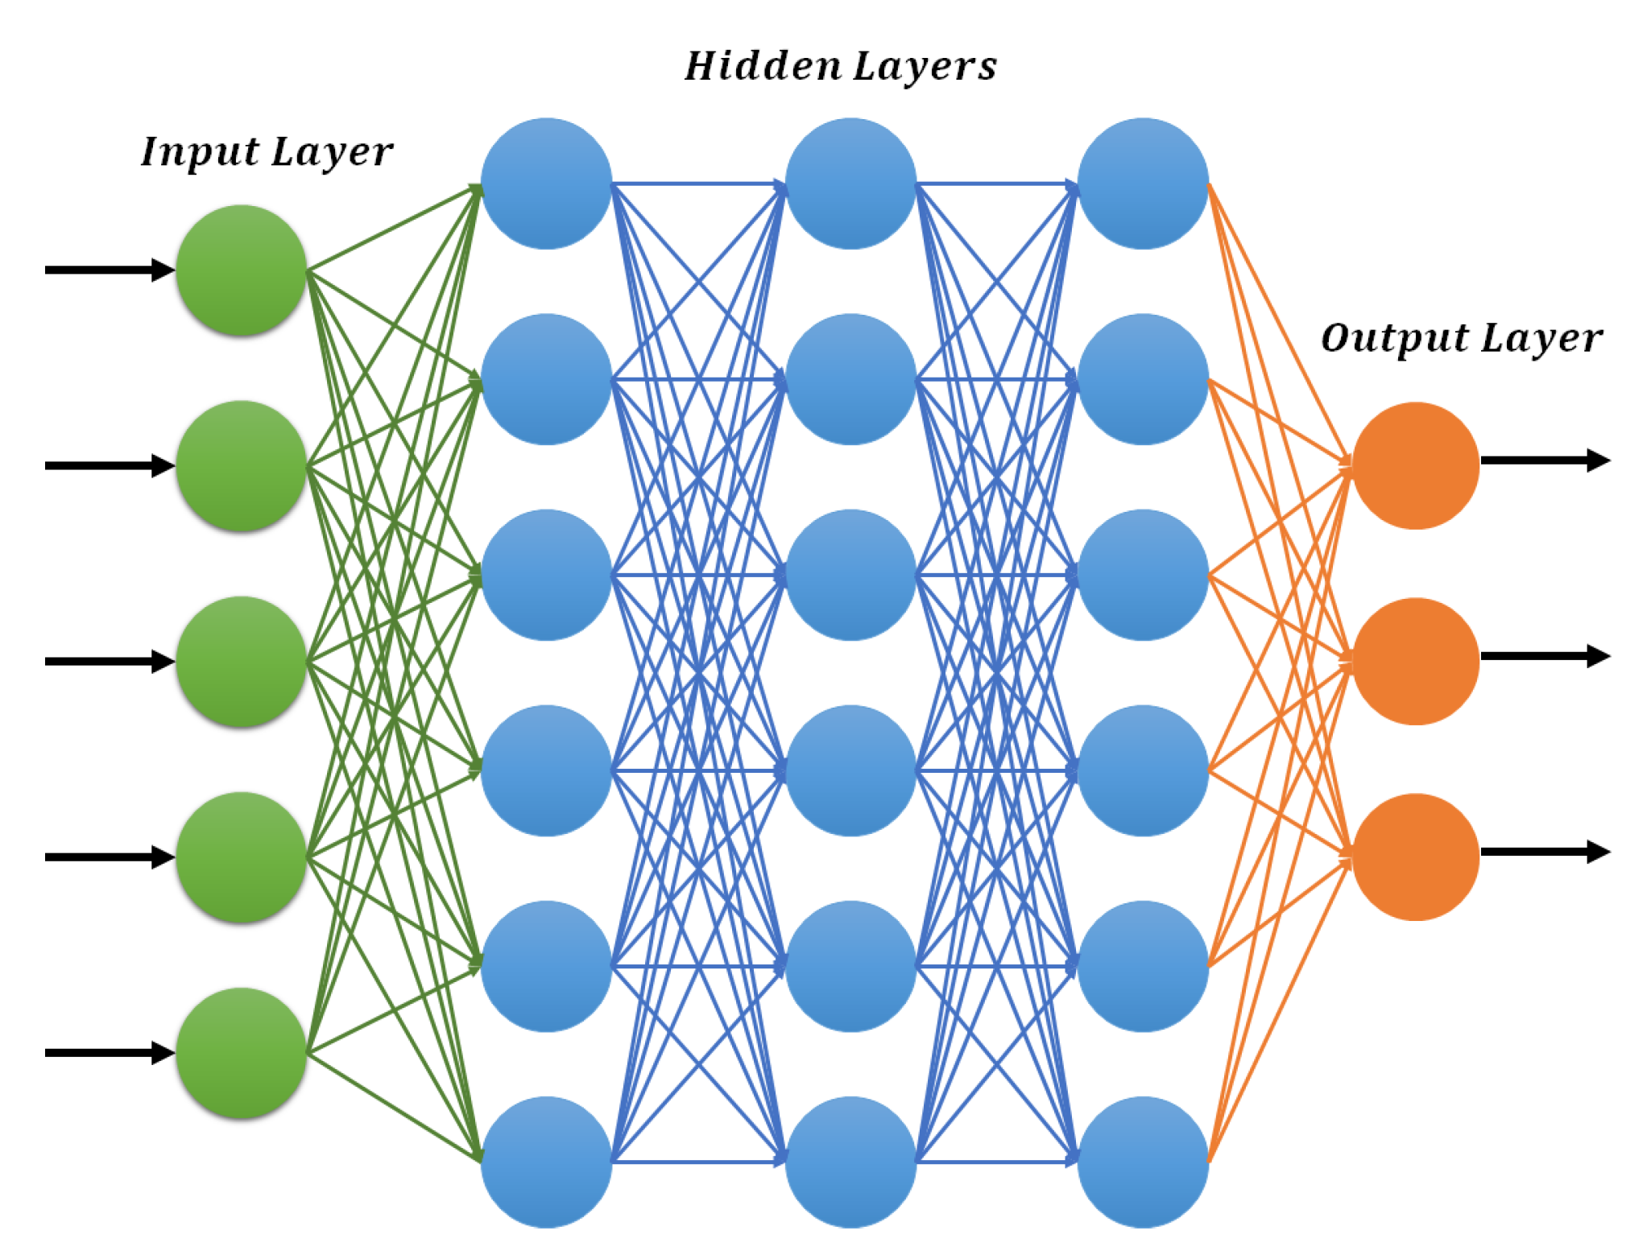
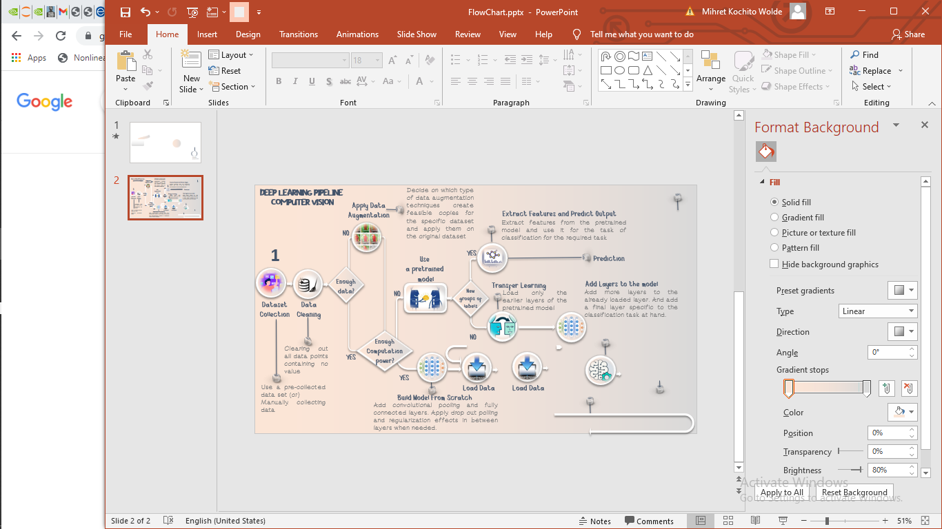



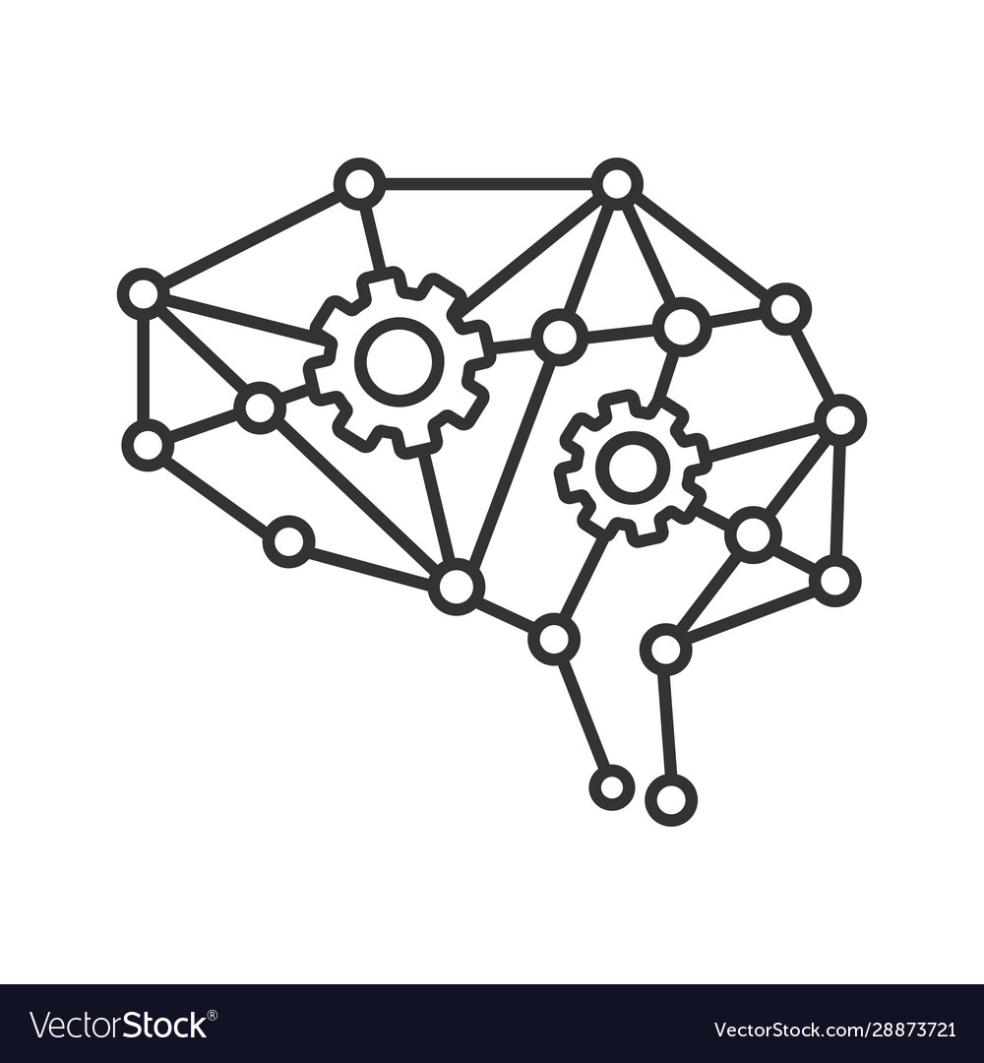
MODEL DEVELOPMENT
USE MOBILENET AS
BASE MODEL
FEATURE EXTRACTION
FINE TUNING
NO
DATASET COLLECTION
CLEAN &
LOAD DATA
TRAIN: DEV: TEST
SPLIT
AUGMENT
DATA
TRAINING ACCURACY = 97.56%
VALIDDATION ACCURACY =97.6%
COMPILE
MODEL
PROCESS
DATA
FIT DATA
TO MODEL
SAVE BEST MODEL

Slide 6

TECHNOLOGY USED
Programming language, tools and frameworks used
Flutter, DJango, Python
Keras, NVDIA’s GPU
6

Slide 7
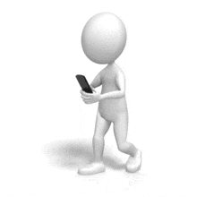

TARGETED USERS
Targeted users are farmers.
Living in rural areas
A farmer of any age
Basic smart phone mobile
Able to take pictures
Able to read suggested information
Self Employed

Slide 8

CHALLENGES FACED
Data Scarcity : found data for limited crop variety
Variation in distribution of data used for training and expected for deployment stage
Installation of some packages like TensorFlow and
Integration issues

Slide 9
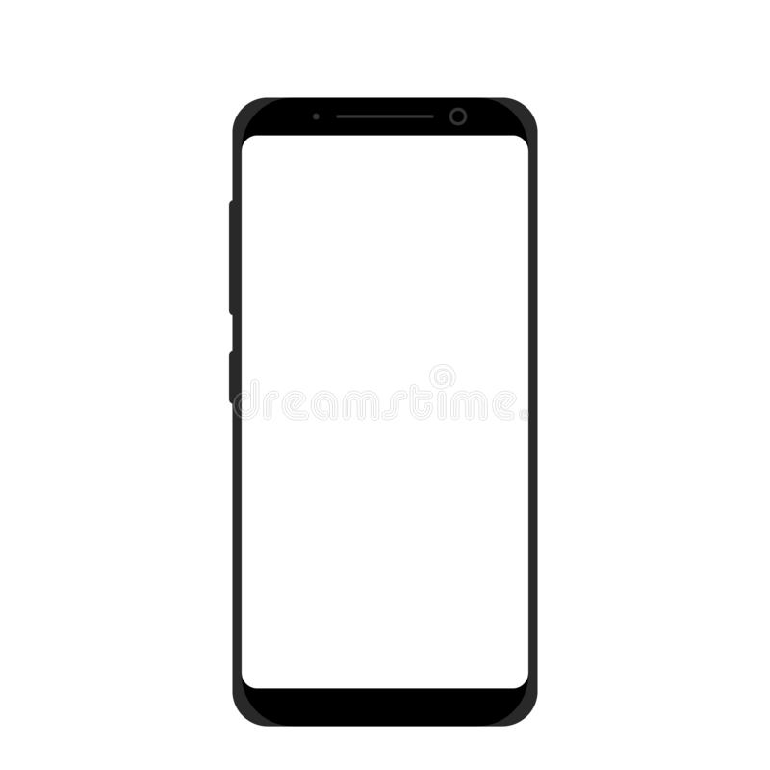
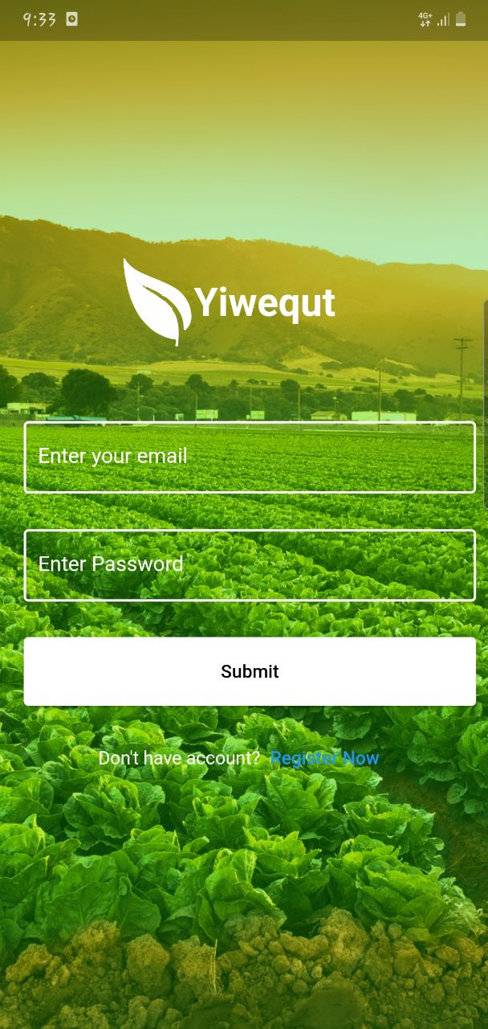
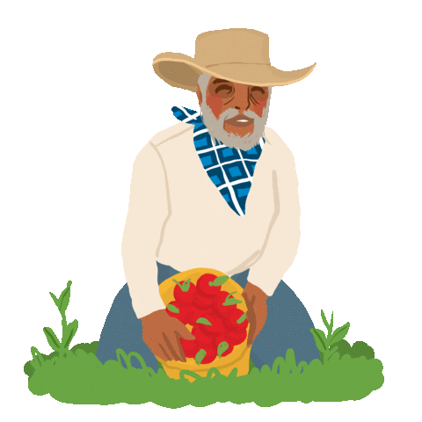
MOBILE
APPLICATION

Slide 10

MADE BY
Hanan Miftah – Leader Developer
Eden Takele - Developer
Mihret Kochito - Model Developer
Hagernesh Tadesse - Technical Writer
Henok Matheas - Programmer
Abnet Belay - Creative Designer
10

Slide 11

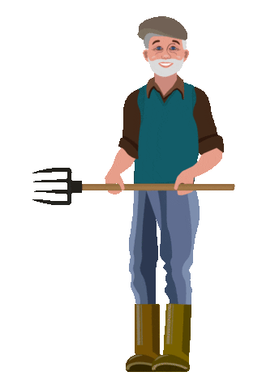
DEMO
11

